Slide 1
3.4 Quadratic Variation

Slide 2
3.4.1 First-Order Variation
3.4.2 Quadratic Variation
3.4.3 Volatility of Geometric Brownian Motion

Slide 3
3.4.1 First-Order Variation
We wish to compute the amount of up and down oscillation undergone by this function between times 0 and T, with the down moves adding to rather than subtracting from the up moves.

Slide 4
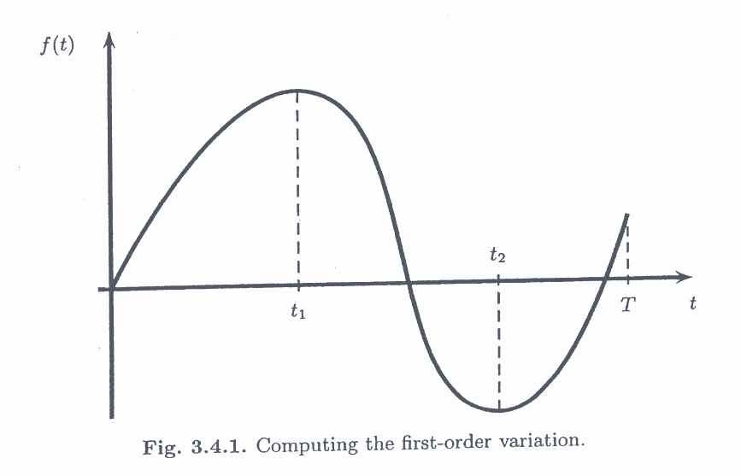

Slide 5
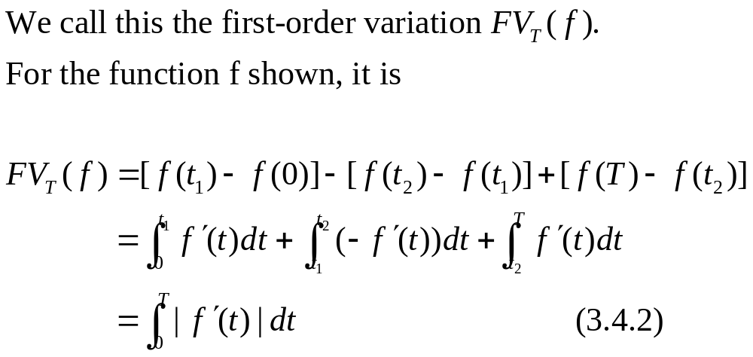
One example

Slide 6
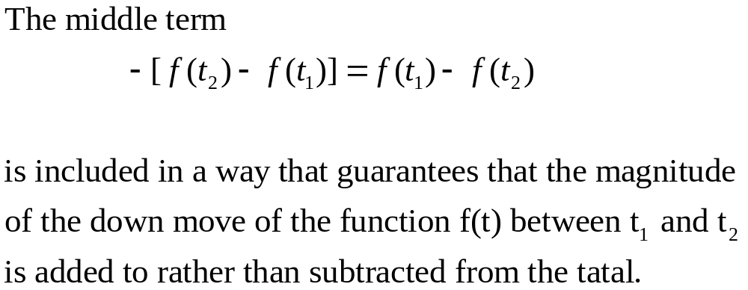

Slide 7
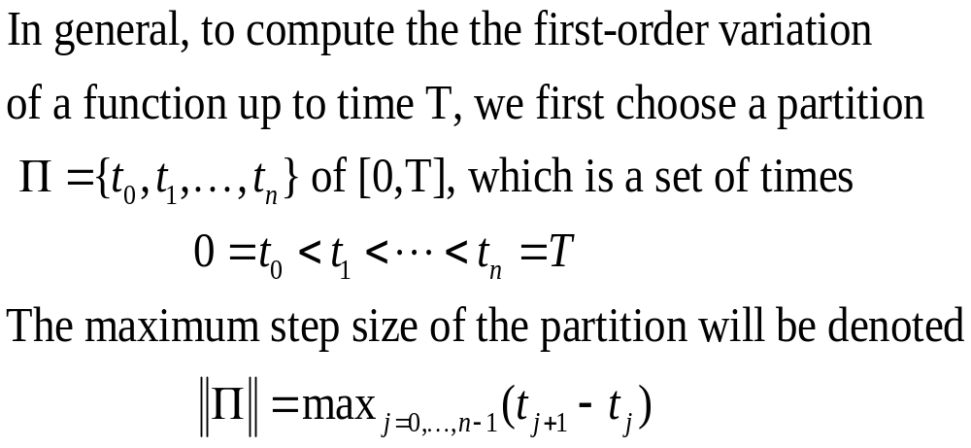

Slide 8
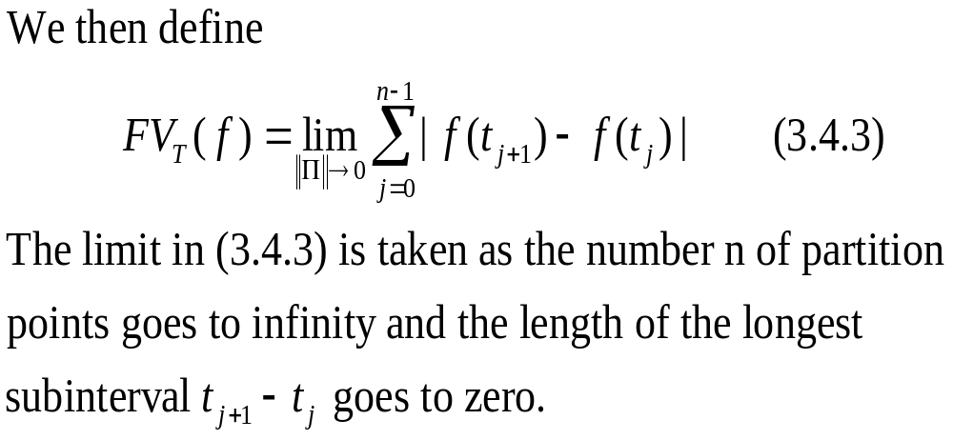

Slide 9
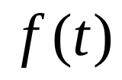

Our first task is to verify that the definition (3.4.3) is consistent with the formula (3.4.2) for the function shown in Figure 3.4.1.
To do this, we use the Mean value Theorem, which applies to any function whose derivative is defined everywhere.

Slide 10
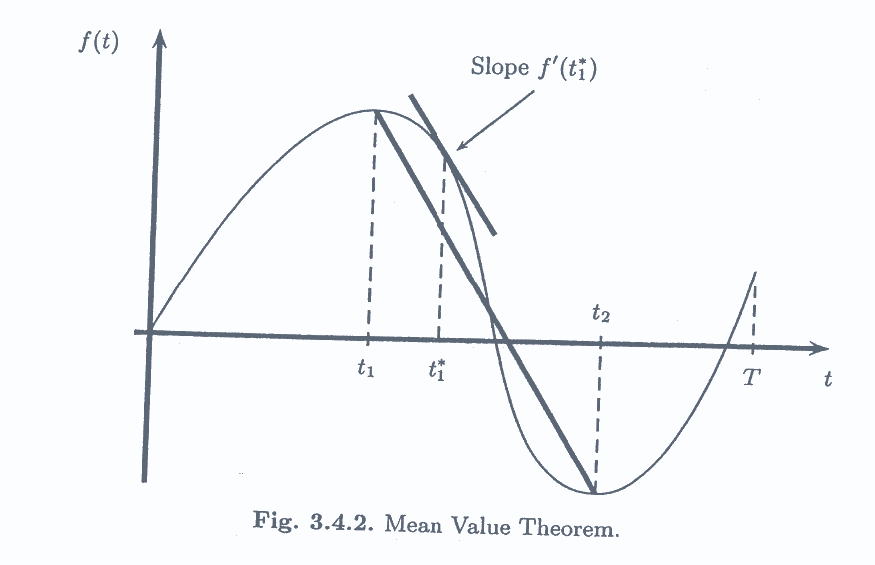

Slide 11
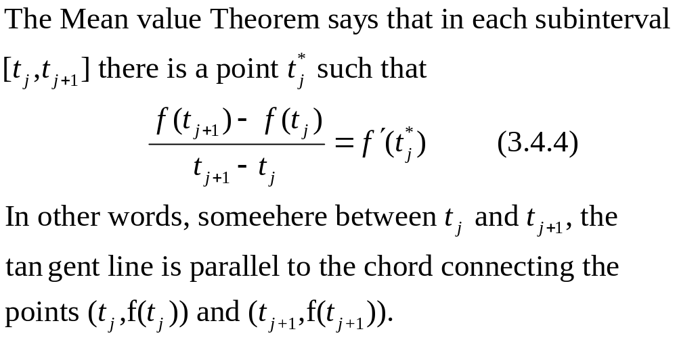

Slide 12
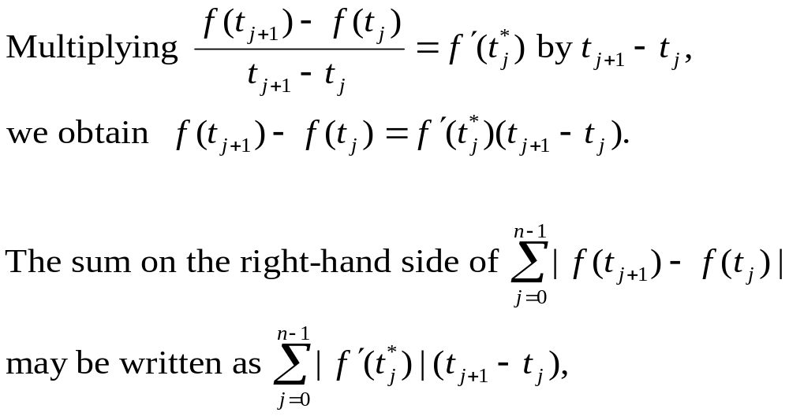

Slide 13
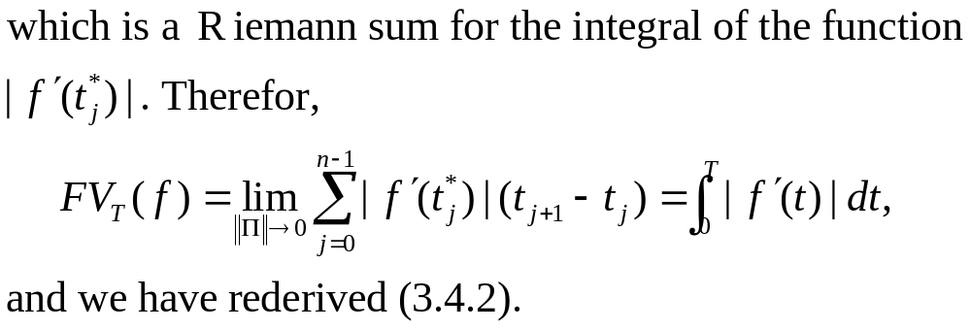

Slide 14
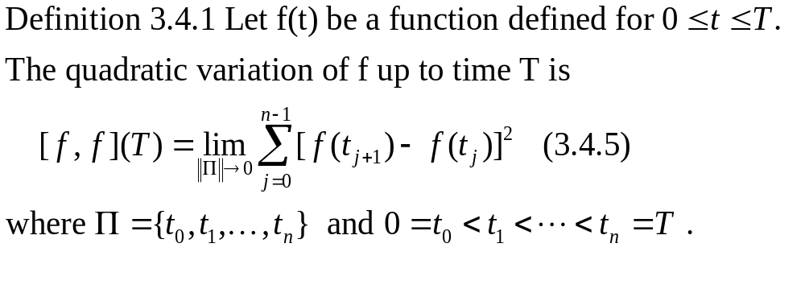
3.4.2 Quadratic Variation

Slide 15
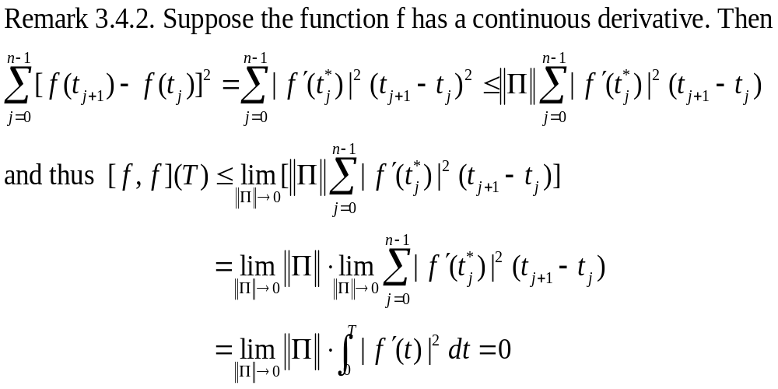

Slide 16
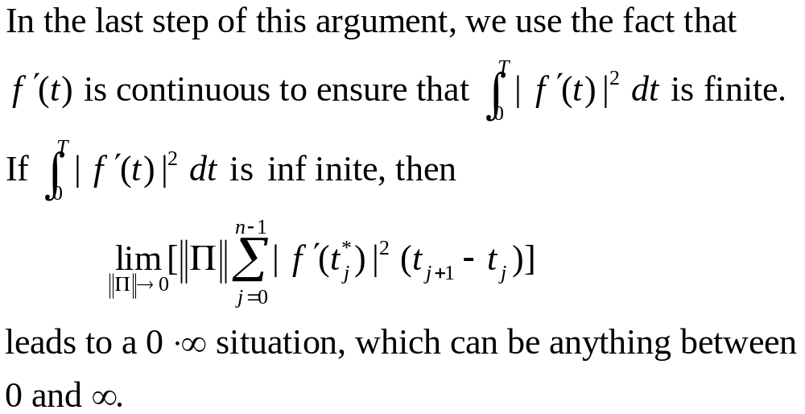

Slide 17
Most functions have continuous derivatives, and hence their quadratic variation are zero. For this reason, one never consider quadratic variation in ordinary calculus.
The paths of Brownian motion, on the other hand, cannot be differentiated with respect to the time variable.

Slide 18
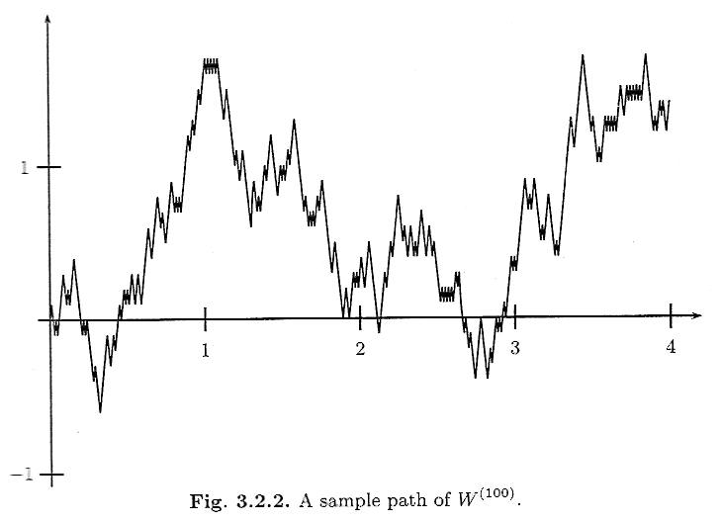

Slide 19
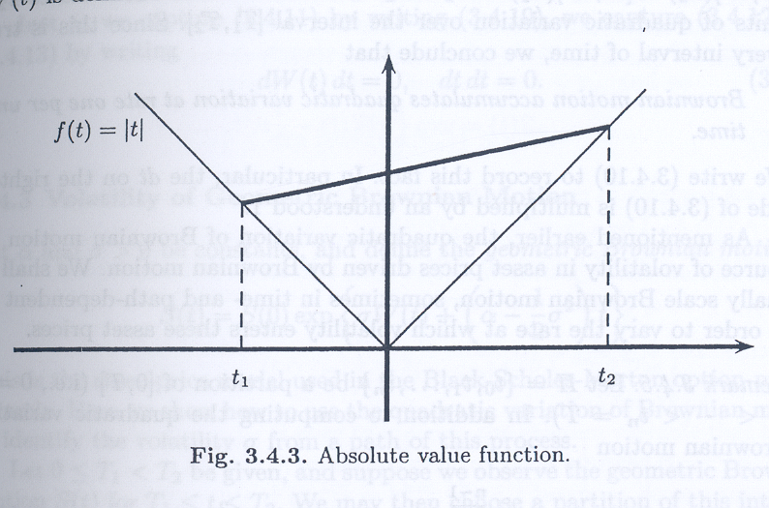

Slide 20


continuous derivative
[f,f](T)=0
[f,f](T)=0
ex: |t|
not continuous derivative
[f,f](T) 0
ex:布朗運動

Slide 21
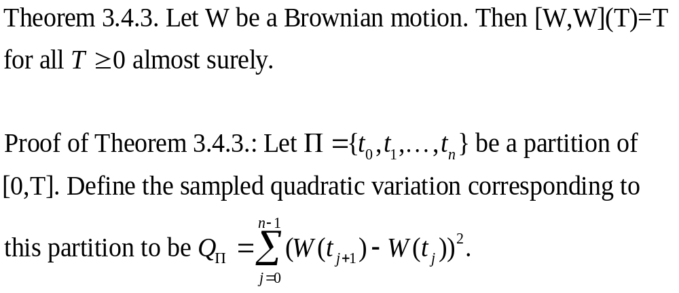

Slide 22
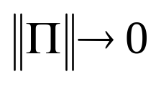
We must show that this sampled quadratic variation, which is a random variable converges to T as .
We shall show that it has expected value T, and its variance converges to zero. Hence, it converges to its expected value T, regardless of the path along which we are doing the computation.

Slide 23
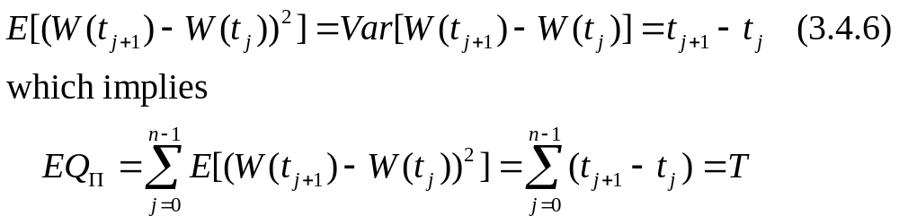
The sampled quadratic variation is the sum of independence random variables. Therefore, its mean and variance are the sums of the means and variances of these random variables. We have

Slide 24
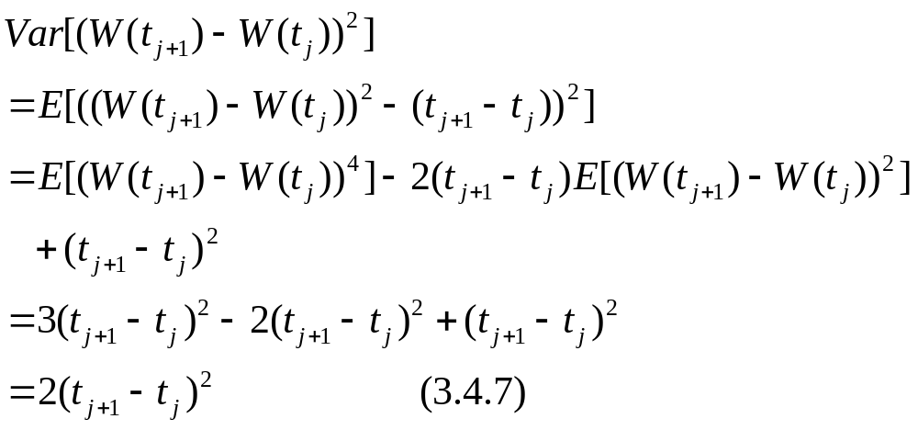

Slide 25
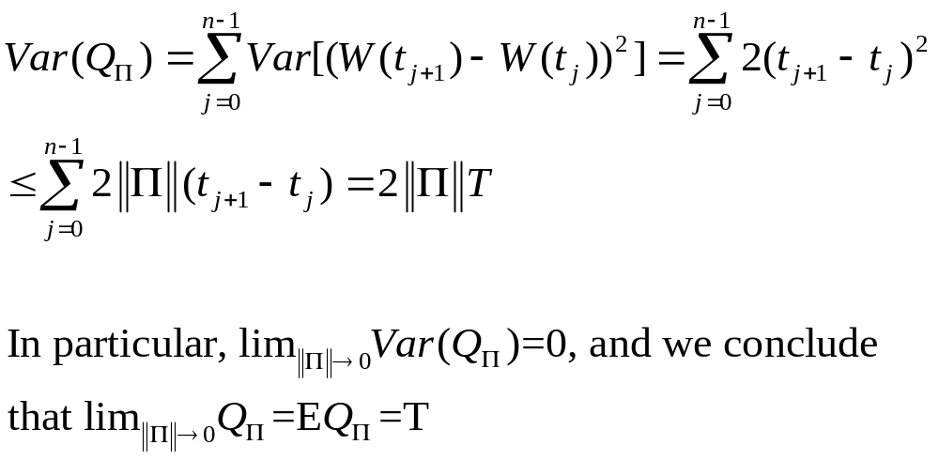

Slide 26
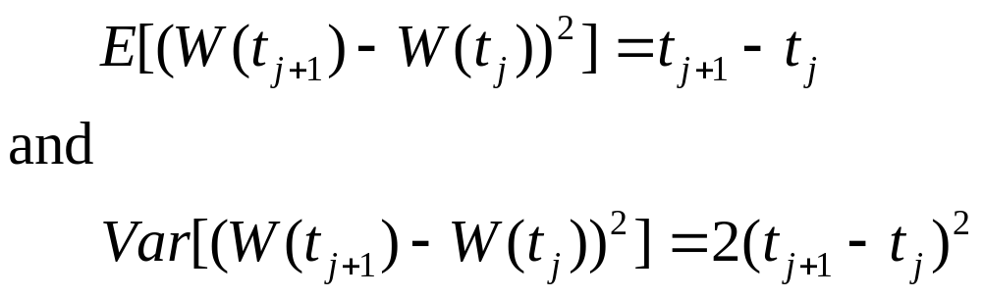
Remark 3.4.4. In the proof above, we derived (3.4.6) and (3.4.7):

Slide 27
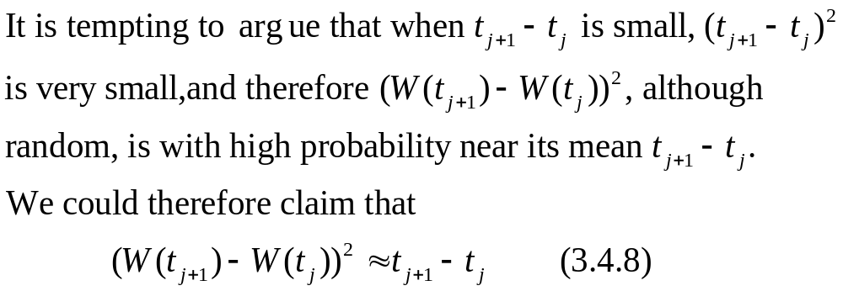

Slide 28
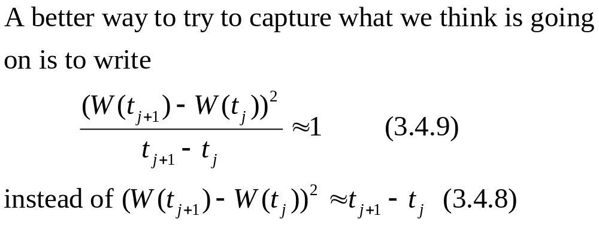

Slide 29
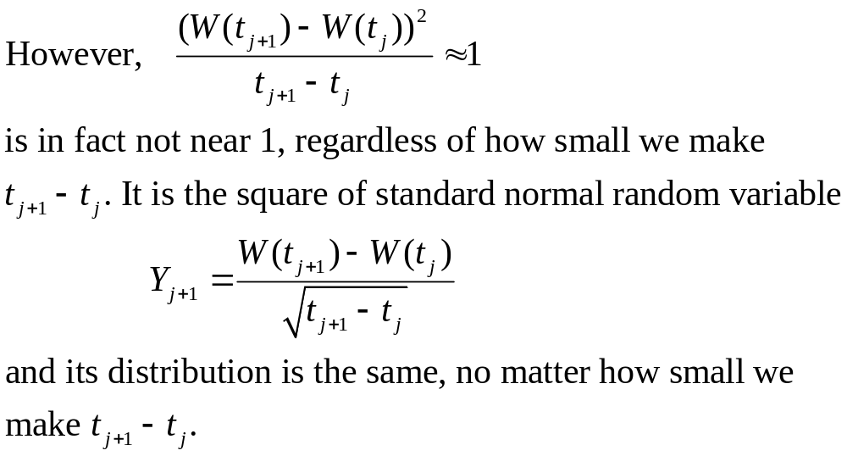

Slide 30
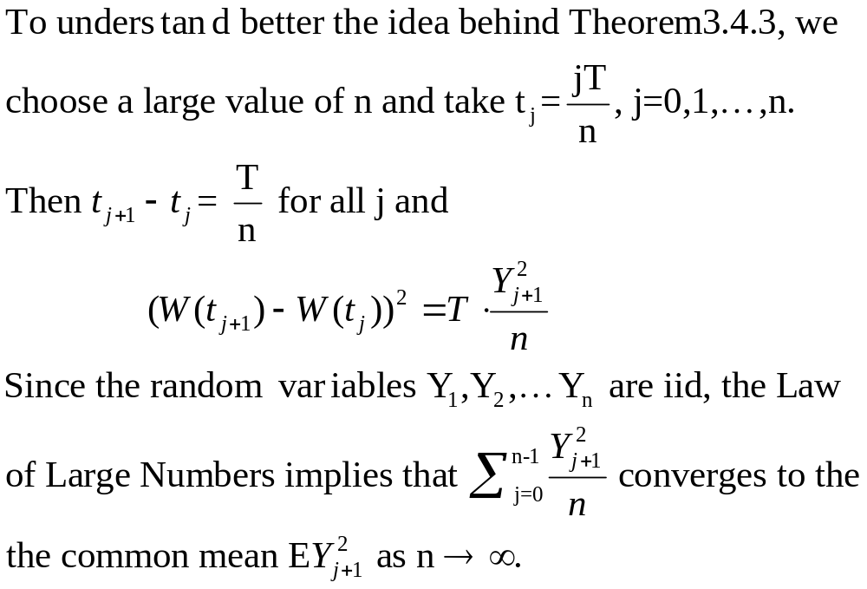

Slide 31
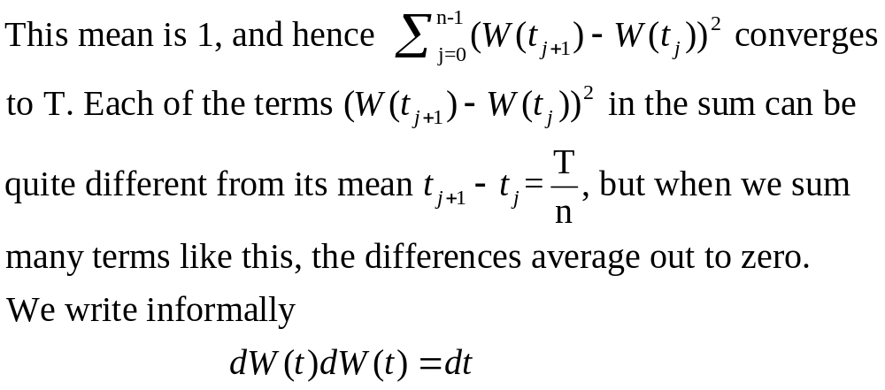

Slide 32
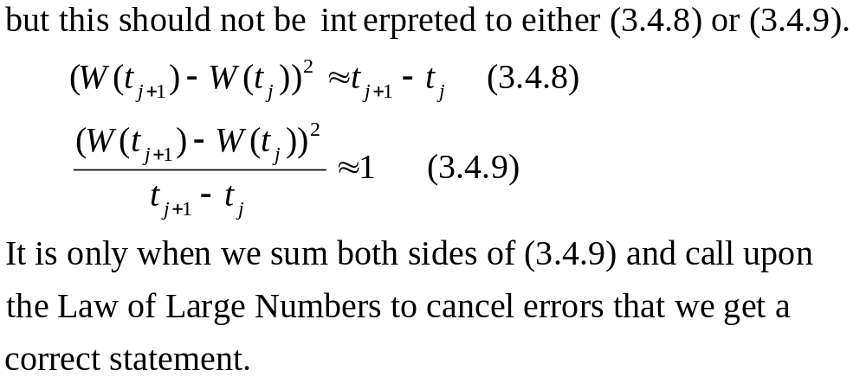

Slide 33

The statement is that on an interval [0,T], Brownian motion accumulates T units of quadratic variation.
Brownian motion accumulates quadratic variation at rate one per unit time.
In particular, the dt on the right-hand side of
is multiplied by an understood 1.

Slide 34
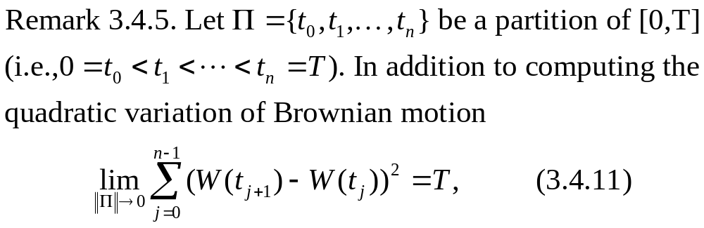

Slide 35
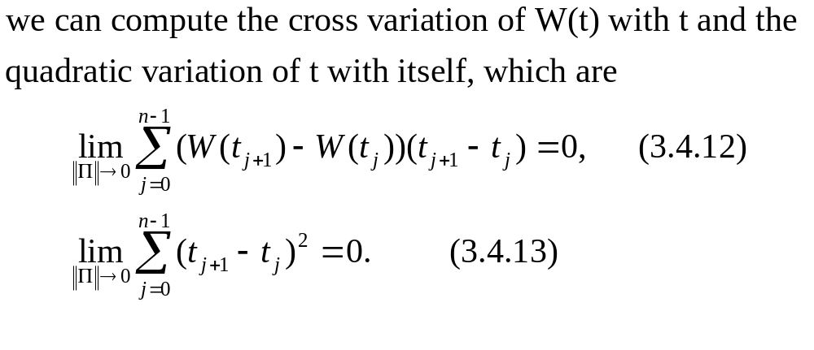

Slide 36
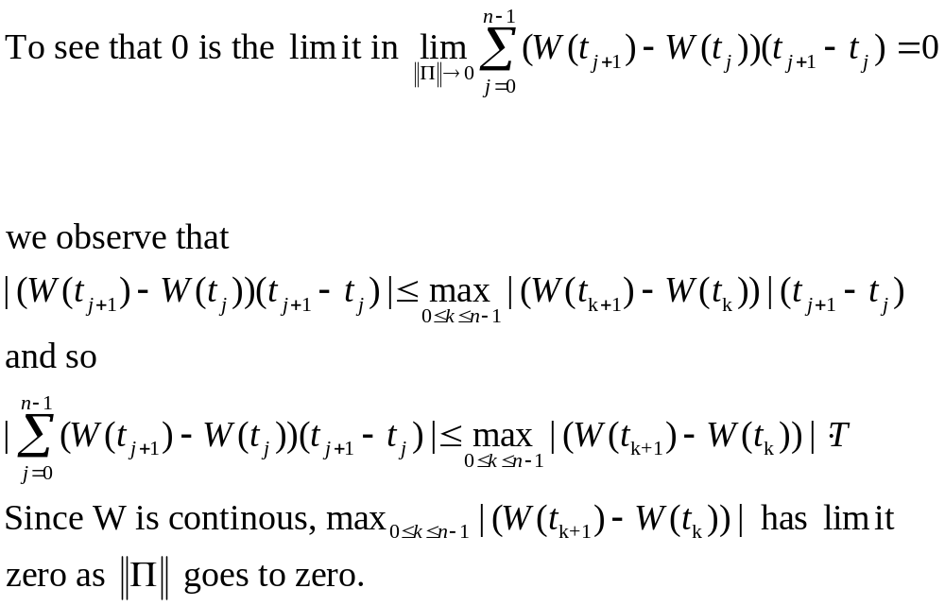

Slide 37
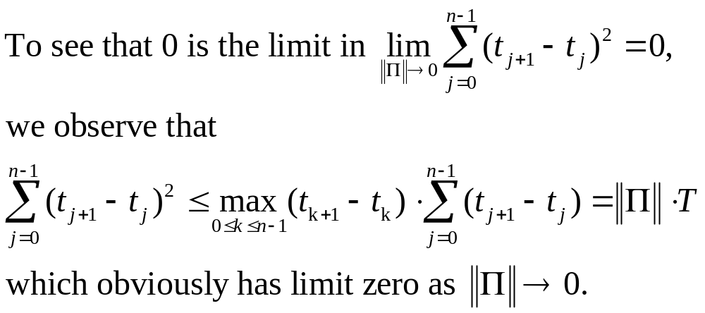

Slide 38
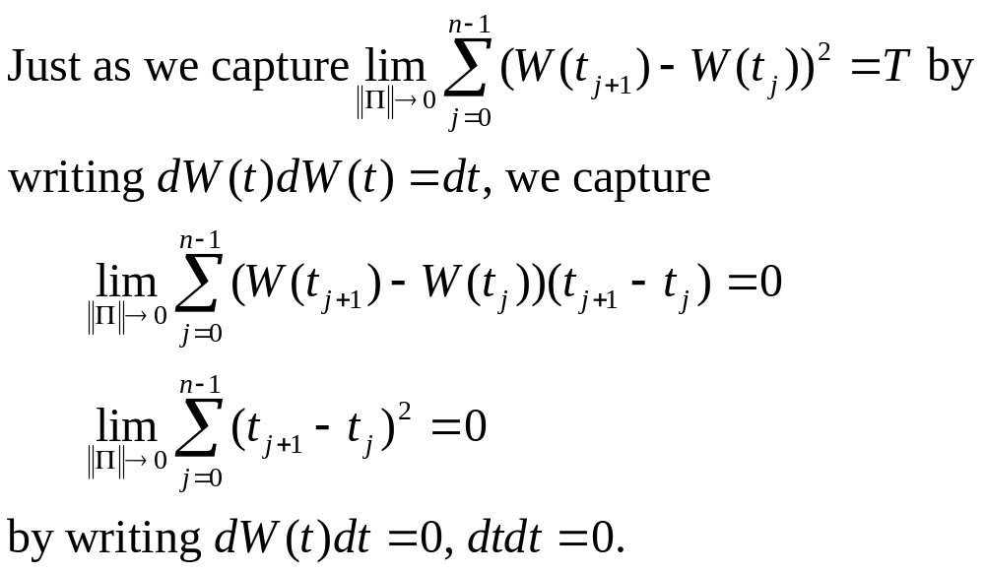

Slide 39
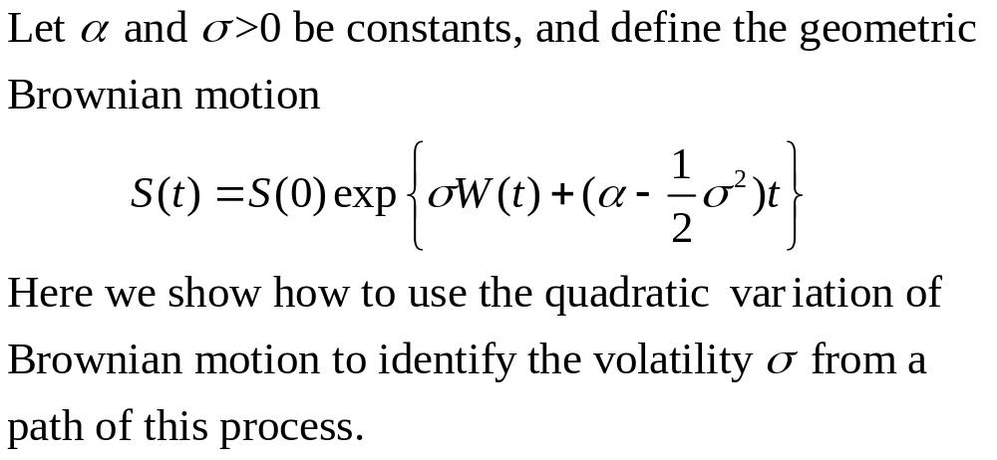
3.4.3 Volatility of Geometric Brownian Motion

Slide 40
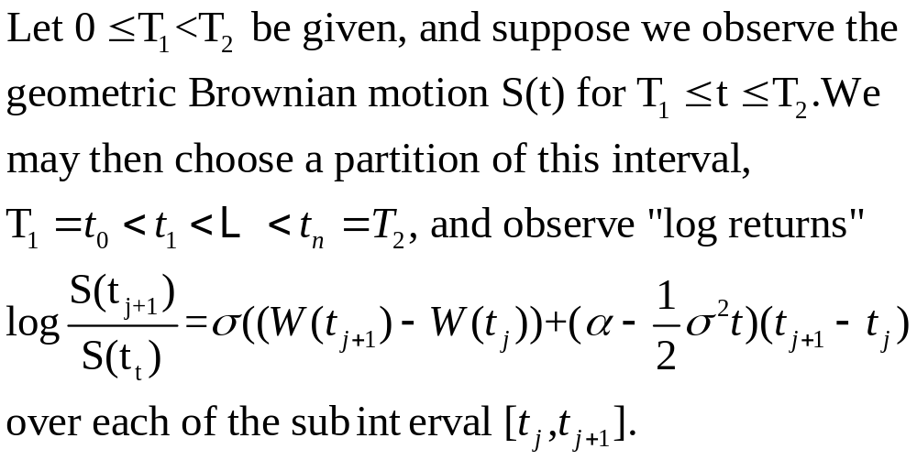

Slide 41
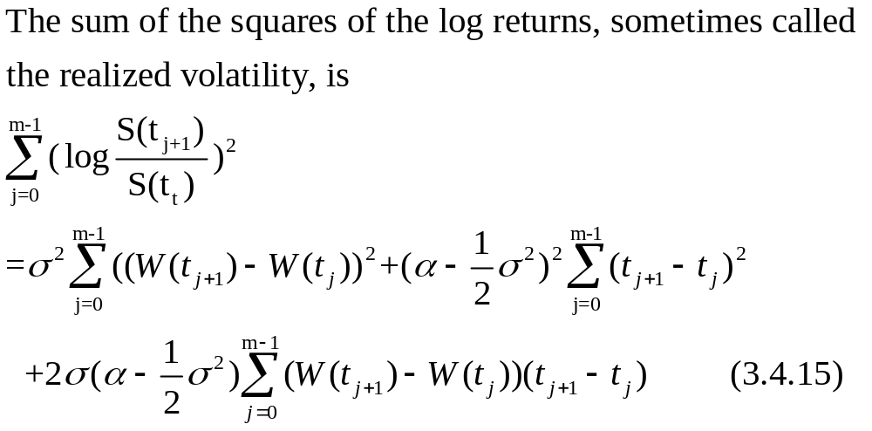

Slide 42
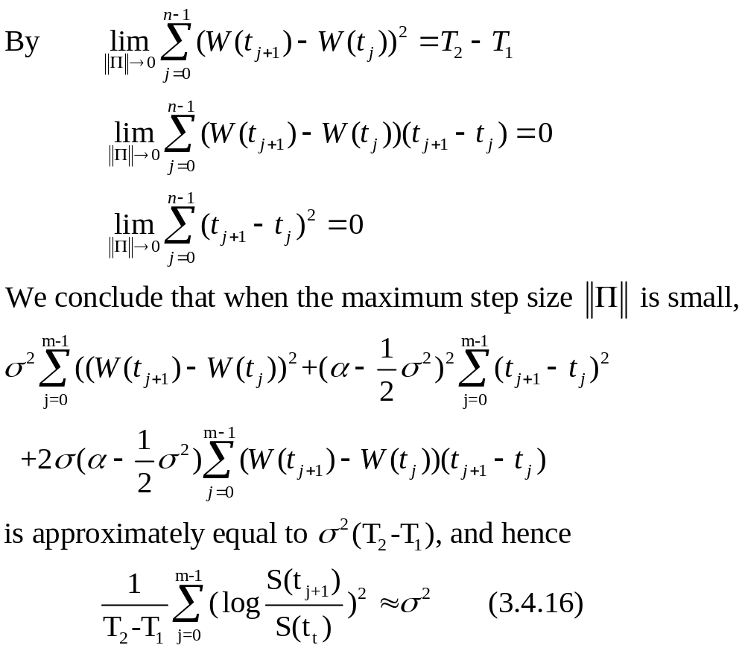

Slide 43
In theory, we can make this approximation as accurate as we like by decreasing the step size. In practice, there is a limit to how small the step size can be.
On small time intervals, the difference in prices due to the bid-ask spread can be as large as the difference due to price fluctuations during the time interval.

Slide 44
名詞解釋 bid-ask spread
當股票的最高買價大於等於最低賣價的時候，就會有股票成交；所以當最高買價小於等於最低賣價的時候不會有股票成交，且中間就會有一個價差，稱為bid-ask spread。

Slide 45
~Thanks for your coming~

